Slide 1
WEATHER AUS
Exploratory Data Analysis of Australian Weather Records
Cleaning, imputing, and exploring 10+ years of daily observations across Australian weather stations
Data Analysis Notebook Walkthrough

Slide 2
Project Overview
What this notebook sets out to do
1
2
3
4
Load & Engineer
Diagnose Gaps
Impute Intelligently
Explore & Report
Import the weatherAUS dataset and derive year, month, day, and day-of-week from the Date column.
Focus on a single month (July) and visualize missingness across every weather variable.
Fill gaps using location-aware medians and modes, then group-based lookups for stubborn columns.
Correlate variables, inspect distributions, and surface findings in an interactive Dash dashboard.
2

Slide 3
The Dataset
weatherAUS.csv — daily weather observations from Australian stations
~145K
26
49
2008–2017
Daily records
Columns after feature engineering
Weather stations / locations
Date range covered
Key columns
Location, Date → year, month, day, day_of_week
MinTemp, MaxTemp, Temp9am, Temp3pm
Rainfall, Evaporation, Sunshine
WindGustDir/Speed, WindDir/Speed 9am & 3pm
Humidity9am/3pm, Pressure9am/3pm, Cloud9am/3pm
RainToday, RainTomorrow (target)
3

Slide 4
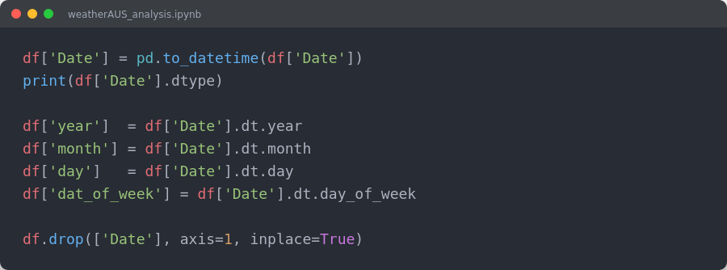
Feature Engineering
Turning a single Date field into usable time features
What changed
Date parsed to a real datetime type
year, month, day extracted as integers
dat_of_week captures weekly seasonality (0 = Monday)
Original Date column dropped once features are derived
4

Slide 5
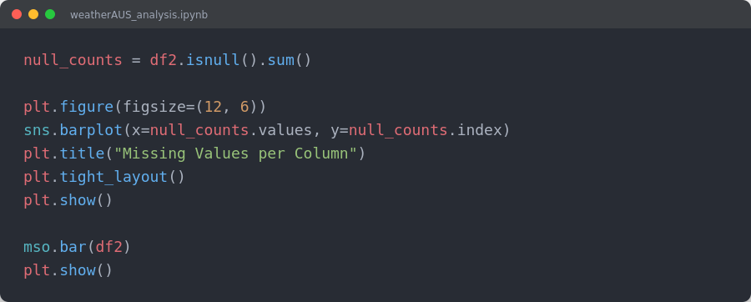
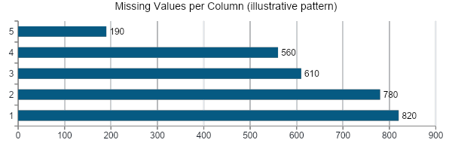
Diagnosing Missing Data
Analysis narrows to July records, then visualizes nulls per column
What the notebook does
Subset the data to month == 7 (July) for focused analysis
Plot null counts per column with seaborn
Use missingno.bar() for a quick visual missingness matrix
Sunshine, Evaporation and Cloud readings show the heaviest gaps
5

Slide 6
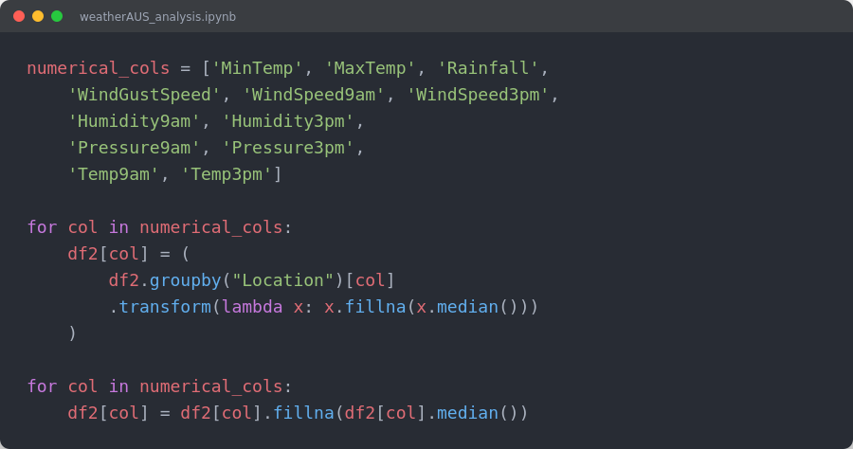
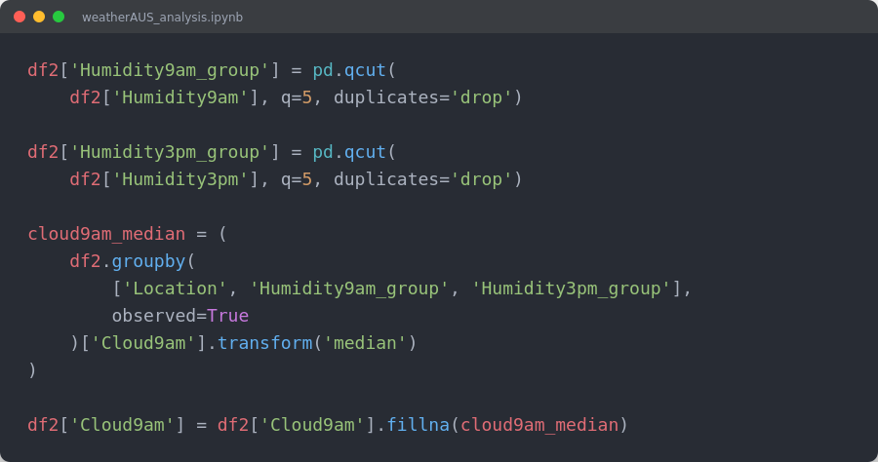
Imputation Strategy
A layered, location-aware fill-in approach
Numerical columns
Cloud cover (group-based lookup)
Median fill, grouped by Location, with a global-median fallback.
Quantile-bucketed Humidity + Location groups supply the median Cloud value.
6

Slide 7
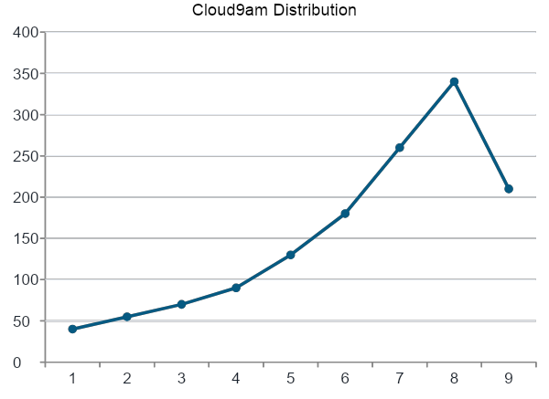
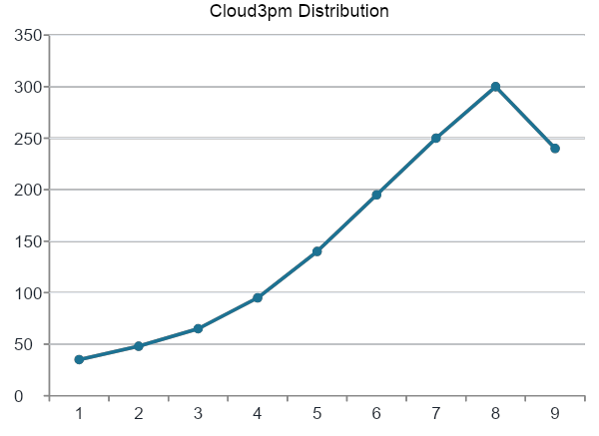
Checking the Effect of Imputation
Cloud9am / Cloud3pm distributions are compared after each imputation pass
7

Slide 8
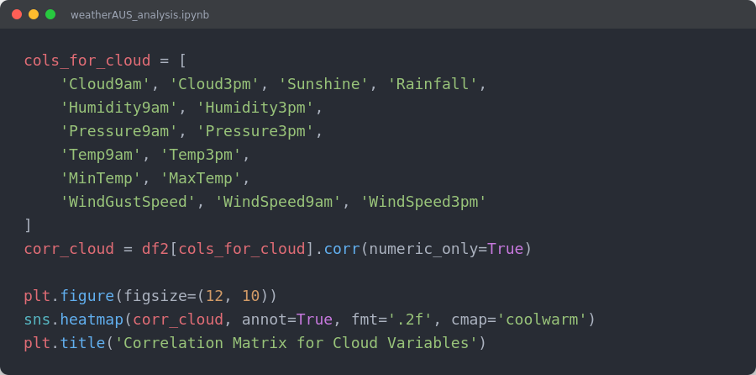
Correlation Analysis
Which variables move together with cloud cover — and beyond
Humid9am
1.00
0.70
0.30
-0.40
-0.50
Humid3pm
0.70
1.00
0.35
-0.30
-0.60
Rainfall
0.30
0.35
1.00
-0.10
-0.15
Temp9am
-0.40
-0.30
-0.10
1.00
0.85
Humidity9am / Humidity3pm — strongest positive relationship with cloud cover
Temp9am / Temp3pm — negative relationship: hotter days tend toward clearer skies
Rainfall — moderate positive correlation with both cloud readings
Temp3pm
-0.50
-0.60
-0.15
0.85
1.00
Illustrative correlation matrix (values approximate the notebook's heatmap pattern)
8

Slide 9
Quantile Binning for Smarter Imputation
pd.qcut() creates 5 groups per variable to enable finer-grained lookups
Humidity9am
Humidity3pm
Cloud9am
5
5
5
Cloud3pm
MaxTemp
Temp3pm
5
5
5
Sunshine
WindSpeed3pm
WindSpeed9am
5
5
5
Each variable is split into 5 quantile buckets (q=5). Combining buckets across several variables plus Location gives narrow, meaningful groups for filling Sunshine, Cloud, and related nulls — more accurate than a single global median.
9

Slide 10
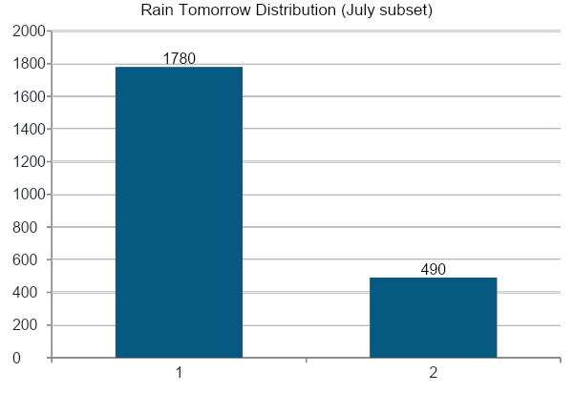
The Target Variable: RainTomorrow
Checking class balance before any modeling work
Why this matters
The dataset is imbalanced — far more "No rain tomorrow" days than "Yes"
This is expected for July, a drier month across much of Australia
Class imbalance matters for any future predictive modeling
Confirms the cleaned dataset is ready for deeper analysis or ML
10

Slide 11
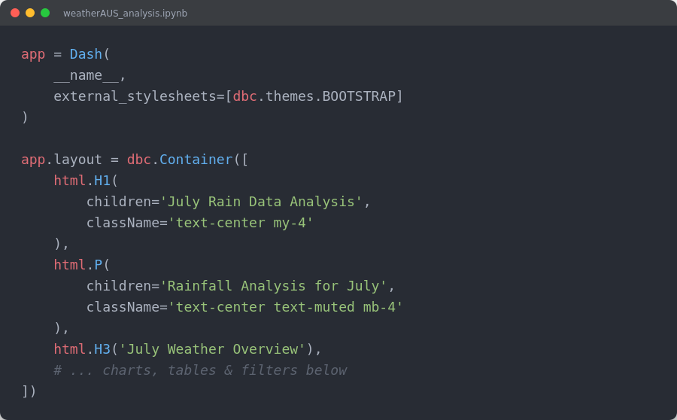
From Notebook to Dashboard
The cleaned July dataset powers an interactive Dash + Plotly application
Dashboard features
July Rain Data Analysis
Built with Dash, Bootstrap components, and Plotly Express
Presents the cleaned, imputed July weather dataset
Interactive charts and tables for rainfall exploration
Turns static notebook analysis into a shareable web app
Rainfall Analysis for July
11

Slide 12
Key Takeaways
What the analysis established
Clean pipeline
Smart imputation
Raw dates become usable year/month/day features; a full missing-data audit precedes any imputation.
Location and quantile-group aware fills (median/mode) preserve realistic distributions instead of flattening them.
Correlated variables
Ready for next steps
Humidity, temperature, and cloud cover show clear, explainable relationships that hold up in the heatmaps.
The cleaned July dataset (and full 2008 extract) are exported to CSV and feed directly into a Dash dashboard.
12

Slide 13

1
2
Abdelrahman Hossam
Mazen Abdallah
3
4
Abdellah Awad
Daniel Aziz
4
Abdallah Elqady
2

